Slide 1
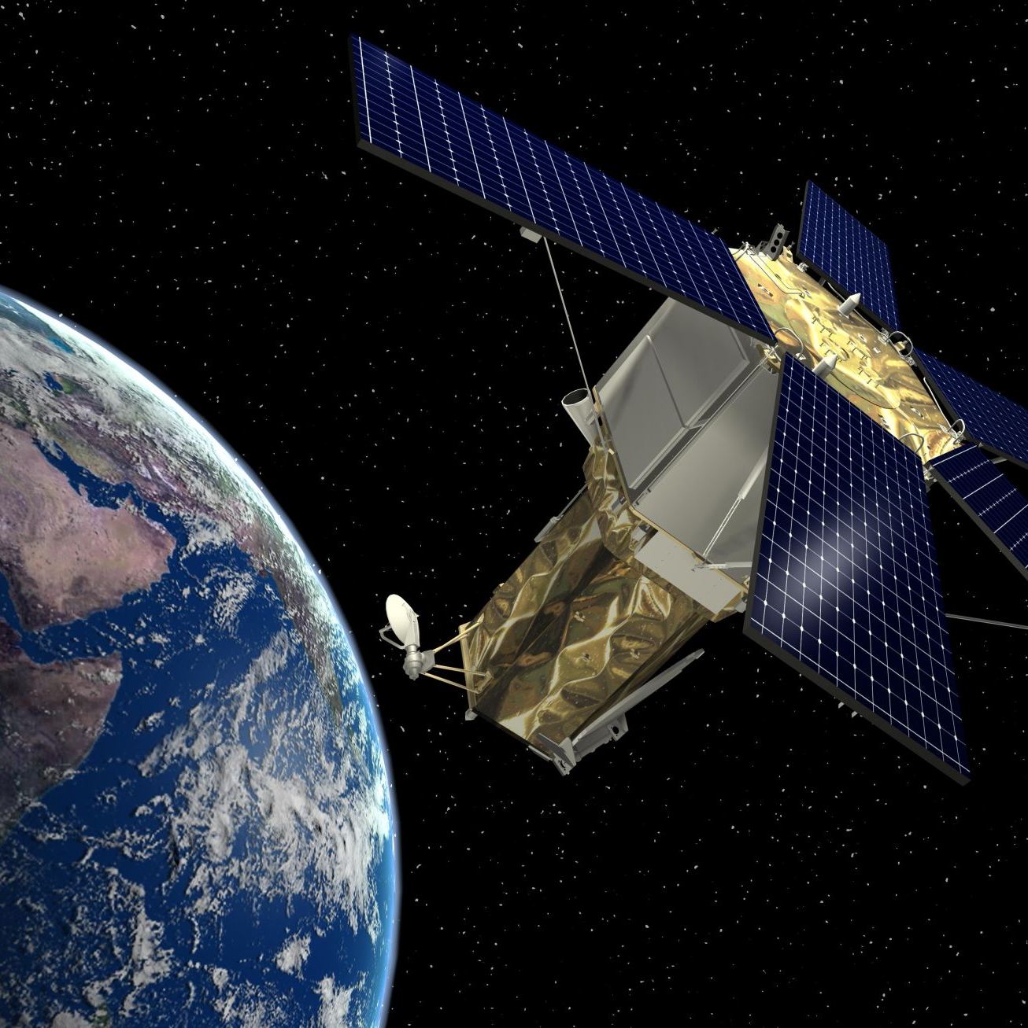
Target Detection
Hyperspectral Remote Sensing

Slide 2


University of Tehran
College of Engineering
Faculty of Surveying and Geospatial engineering
Remote Sensing
Dr. Hasanlou
Faezeh Zamiri
810399040
aghdam.zamiri.fa@ut.ac.ir

Slide 3
Method
Hyperspectral image with N spectral bands
Read image
Target Detection
Otsu
Threshold Selection
Orthogonal Subspace Projection (OSP)
Adaptive Matched Subspace Detector (AMSD)
Compare
ROC curve
Generalized Likehood Ratio Test (GLRT)
Matched Filter
Signed Adaptive Cosine Estimator (S-ACE)
Adaptive Cosine Estimator (ACE)
Constrained Energy Minimization (CEM)
General scheme of Target Detection

Slide 4
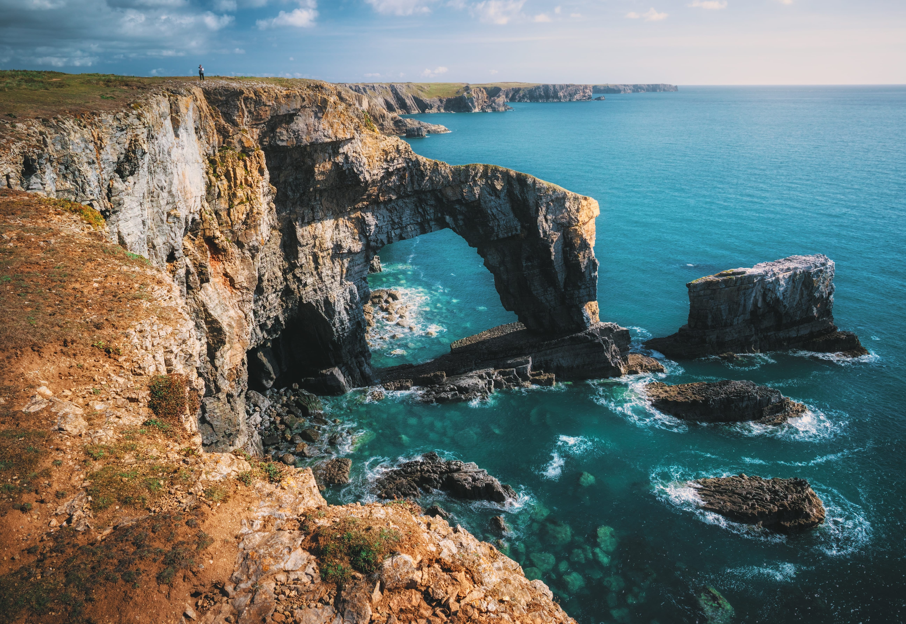




Target Detection
Constrained Energy Minimization
(CEM)
Adaptive Cosine Estimator
(ACE)
Signed Adaptive Cosine Estimator
(S-ACE)
Structured methods for target detection
Matched Filter
Generalized Likehood Ratio Test
(GLRT)
4

Slide 5
Target Detection
Adaptive Matched Subspace Detector (AMSD)
Orthogonal Subspace Projection
(OSP)
Unstructured methods for target detection

Slide 6
Threshold Selection
Otsu
Otsu's method chooses a threshold that minimizes the intraclass variance of the thresholded black and white pixels.
1

Slide 7
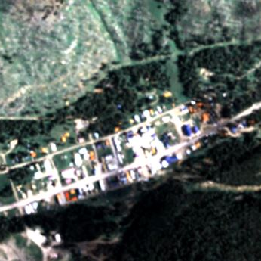
Data
The Cooke City Dataset
(280*800) *126
Data that I used in this exercise.

Slide 8
Result of OTSU Threshold Selection
Method | Fabric 1 | Fabric 2 | Fabric 3 | Fabric 4 | Vehicle 1 | Vehicle 2 | Vehicle 3
CEM | 0.0010 | 0.0028 | 0.0035 | 0.0011 | 0.0032 | 0.0090 | 0.0012
ACE | 0.0155 | 0.0182 | 0.0183 | 0.0159 | 0.0150 | 0.0185 | 0.0164
S-ACE | 0.0135 | 0.0166 | 0.0155 | 0.0136 | 0.0122 | 0.0159 | 0.0134
MF | 0.0010 | 0.0027 | 0.0035 | 0.0011 | 0.0032 | 0.0089 | 0.0012
GLRT | 0.0154 | 0.0180 | 0.0181 | 0.0157 | 0.0149 | 0.0183 | 0.0163
OSP | 0.0026 | 0.0064 | 0.0011 | 0.0028 | 0.0068 | 0.0154 | 0.0021
AMSD | 0.0981 | 0.0783 | 0.0648 | 0.0934 | 0.0903 | 0.1622 | 0.0647

Slide 9
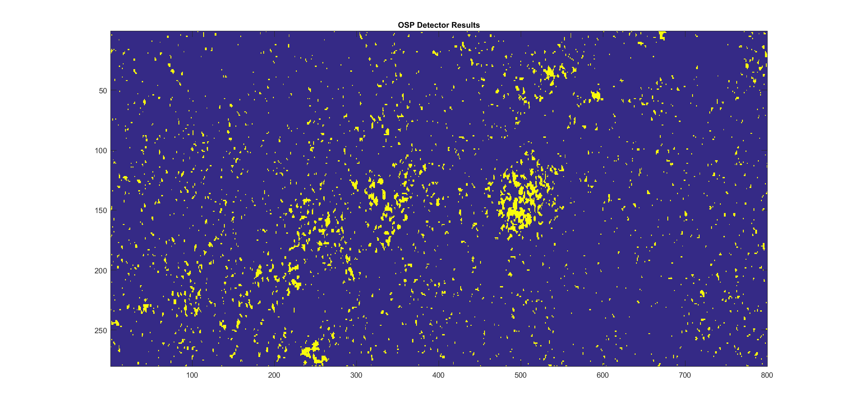
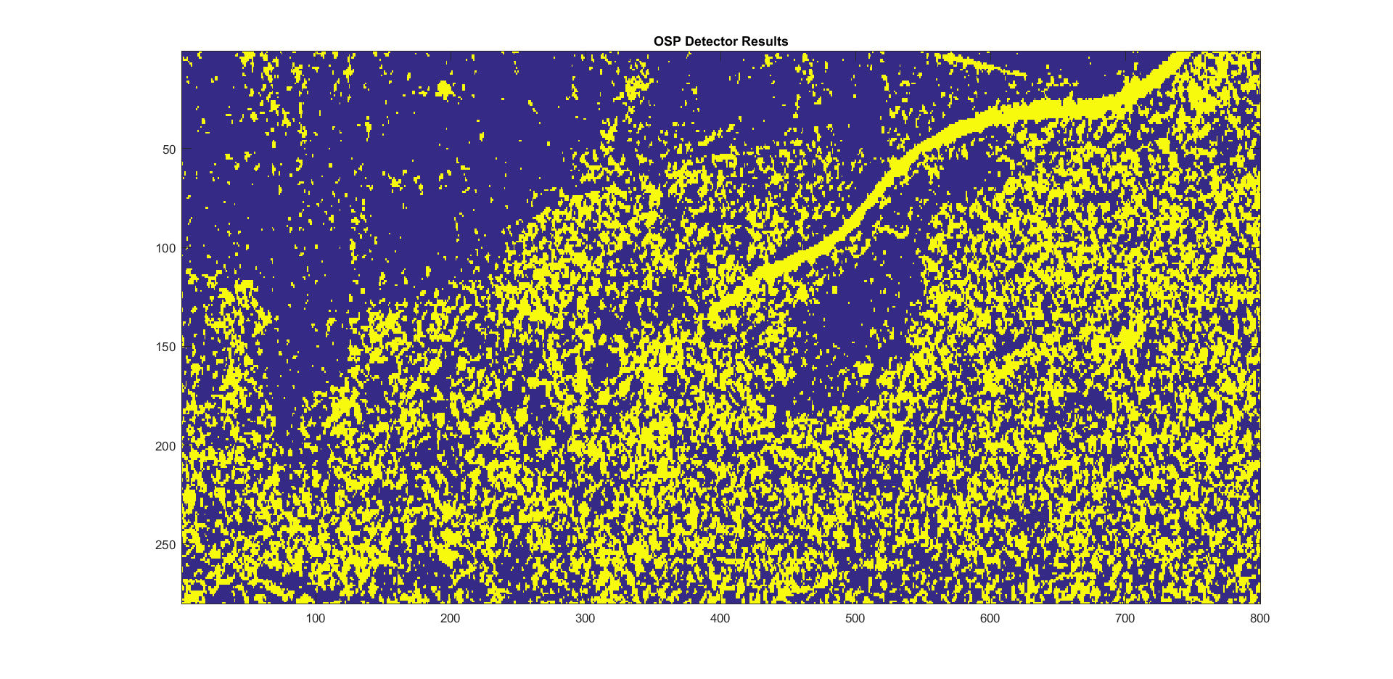
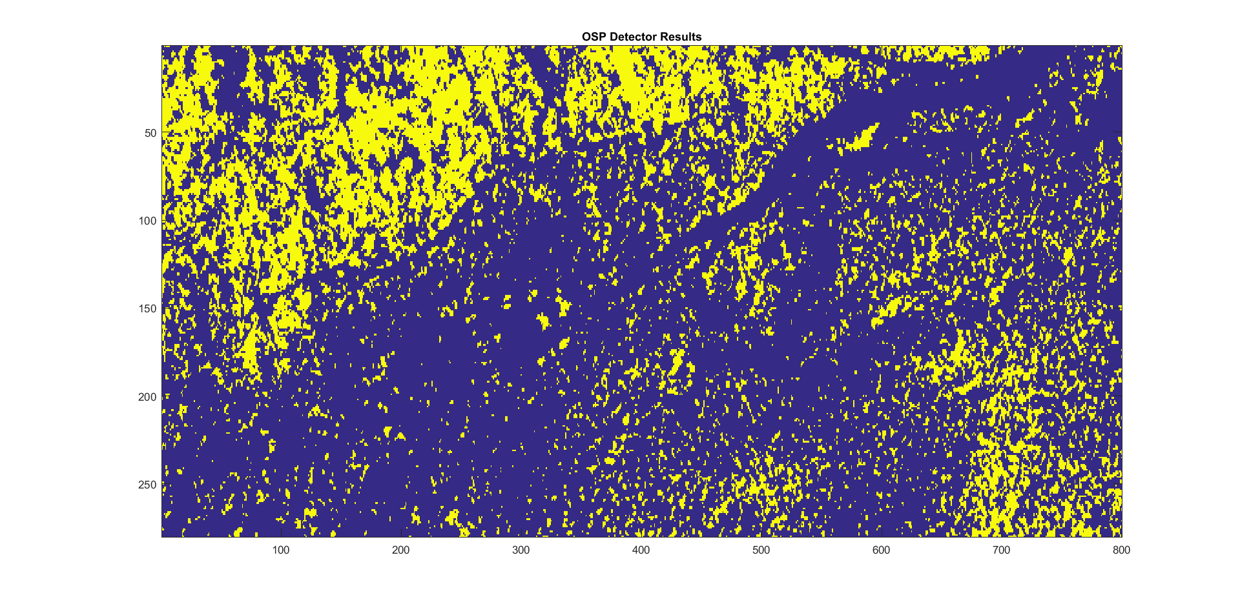
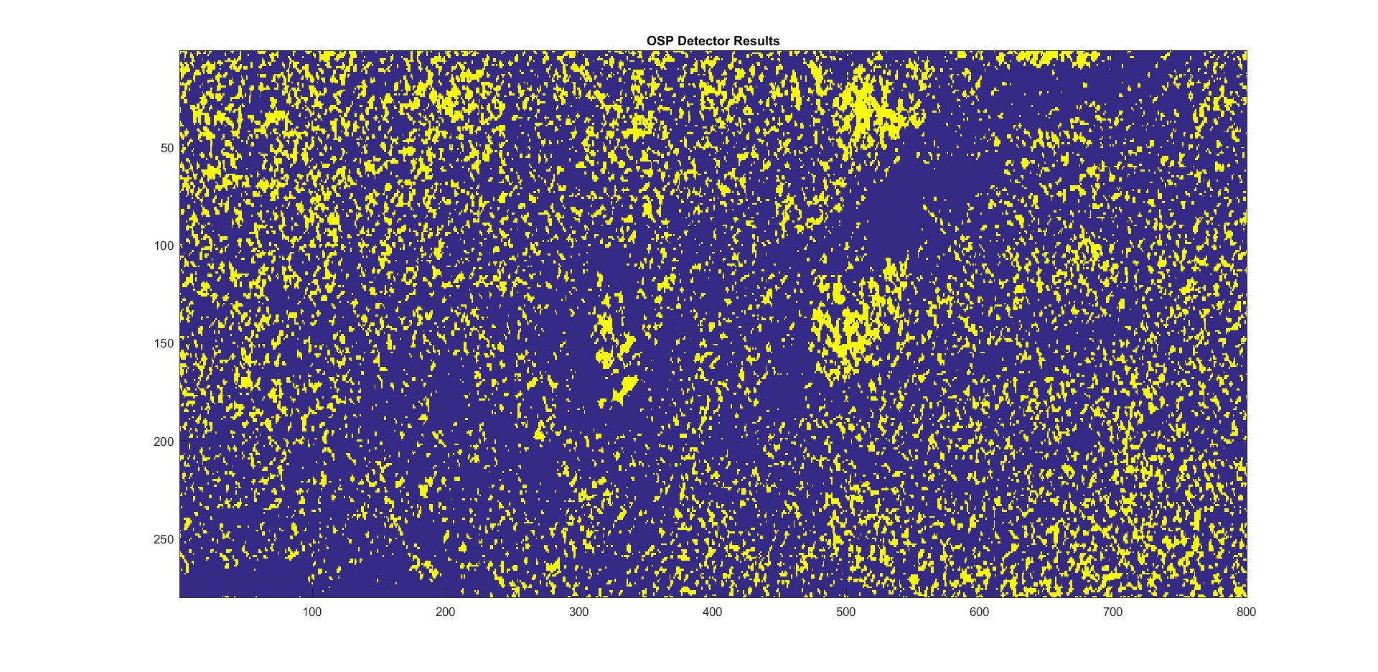
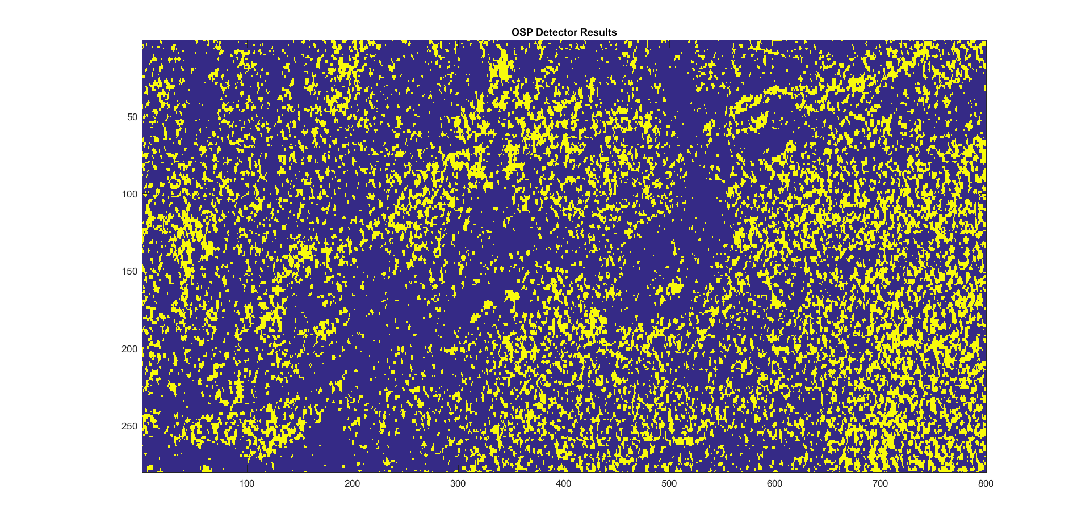
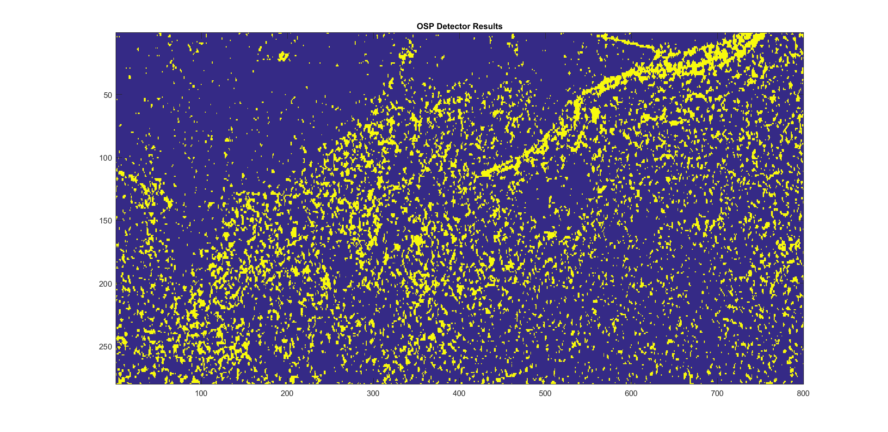
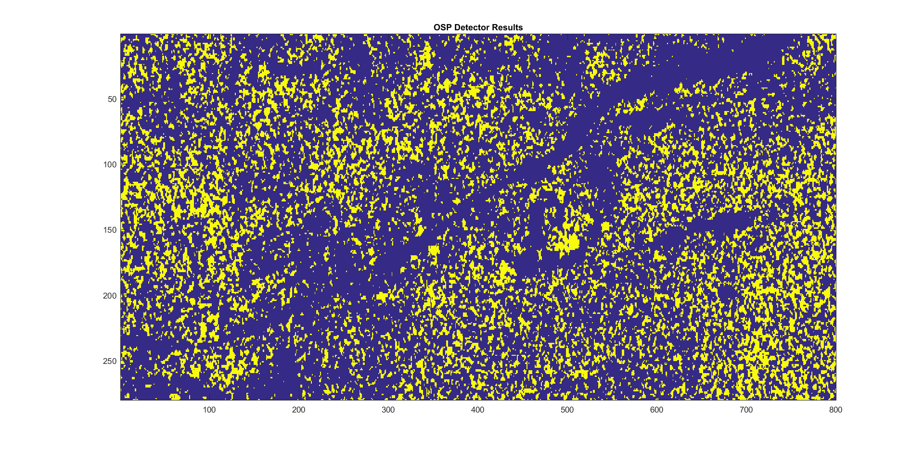
Threshold Selection Result on OSP Method
Fabric 1
T = 0.0026
Fabric 2
T = 0.0064
Fabric 3
T = 0.0011
Fabric 4
T = 0.0028
Vehicle 1
T = 0.0068
Vehicle 2
T = 0.0154
Vehicle 3
T = 0.0021
This algorithm seems to work optimistically or because the amount of target data is small, this algorithm has low accuracy

Slide 10
CEM Constrained Energy Minimization
HYPERCEM Performs constrained energy minimization (CEM) algorithm
Performs the constrained energy minimization algorithm for target detection.
Usage
[results] = hyperCem(M, target)
Inputs
M - 2d matrix of HSI data (p x N) → 126*224000
target - target of interest (p x 1) → 126*1
Outputs
results - vector of detector output (N x 1) → 224000*1
1 of 5 Structured Method

Slide 11
ACE Adaptive Cosine Estimator
HYPERACE Performs the adaptive cosin/coherent estimator algorithm
Performs the adaptive cosin/coherent estimator algorithm for target detection.
Usage
[results] = hyperAce(M, S)
Inputs
M - 2d matrix of HSI data (p x N) ) → 126*224000
S - 2d matrix of target endmembers (p x 1) → 126*1
Outputs
results - vector of detector output (N x 1) → 224000*1
2 of 5 Structured Method

Slide 12
GLRT Generalized Likehood Ratio Test
HYPERGLRT Performs the generalized liklihood test ratio algorithm
Performs the generalized liklihood test ratio algorithm for target detection.
Usage
[results] = hyperGlrt(M, U, target)
Inputs
M - 2d matrix of HSI data (p x N) → 126*224000
t - target of interest (p x 1) → 126*1
Outputs
results - vector of detector output (N x 1) → 224000*1
3 of 5 Structured Method

Slide 13
S-ACE Signed Adaptive Cosine Estimator (S-ACE)
HYPERACE Performs the adaptive cosin/coherent estimator algorithm
Performs the adaptive cosin/coherent estimator algorithm for target detection.
Usage
[results] = hyperSignedAce(M, S)
Inputs
M - 2d matrix of HSI data (p x N) → 126*224000
S - target of interest (p x 1) → 126*1
Outputs
results - vector of detector output (N x 1) → 224000*1
4 of 5 Structured Method

Slide 14
MF Matched Filter
HYPERACE Performs Matched Filter estimator algorithm
Performs the estimator algorithm for target detection.
Usage
[results] = hyperMatchedFilter(M, S)
Inputs
M - 2d matrix of HSI data (p x N) → 126*224000
S - target of interest (p x 1) → 126*1
Outputs
results - vector of detector output (N x 1) → 224000*1
5 of 5 Structured Method

Slide 15
OSP Orthogonal Subspace Projection
HYPEROSP Performs the othogonal subspace projection (OSP) algorithm
Performs the othogonal subspace projection algorithm for target detection.
Usage
[results] = hyperOsp(M, U, target)
Inputs
M - 2d matrix of HSI data (p x N)
U - 2d matrix of background endmebers (p x q)
target - target of interest (p x 1)
Outputs
results - vector of detector output (N x 1)
1 of 2 Unstructured Method

Slide 16
AMSD Adaptive Matched Subspace Detector
HYPERAMSD Adaptive matched subspace detector (AMSD) algorithm
Performs the adaptive matched subspace detector (AMSD) algorithm for target detection
Usage
[results] = hyperAmsd(M, U, target)
Inputs
M - 2d matrix of HSI data (p x N)
B - 2d matrix of background endmebers (p x q)
target - target of interest (p x 1)
Outputs
results - vector of detector output (N x 1)
2 of 2 Unstructured Method

Slide 17
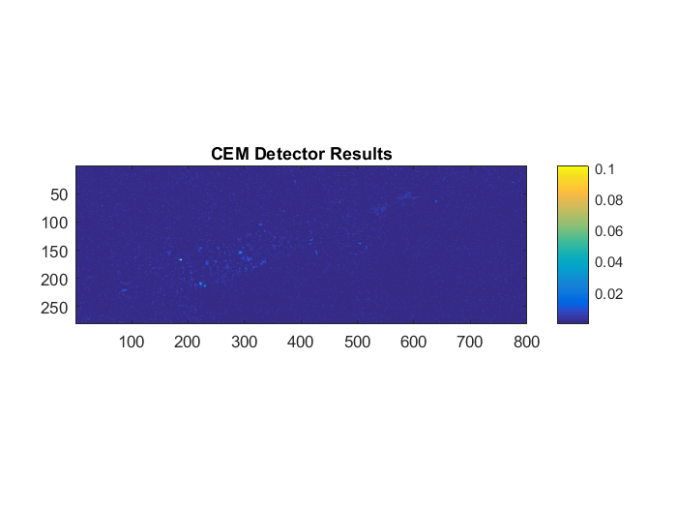
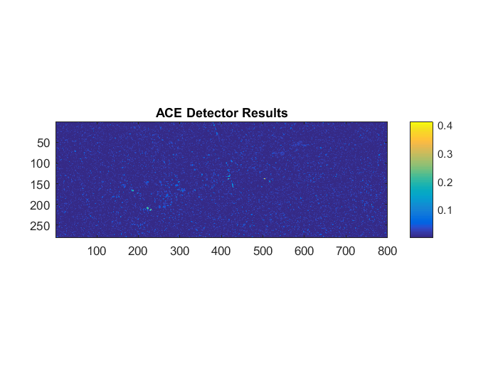
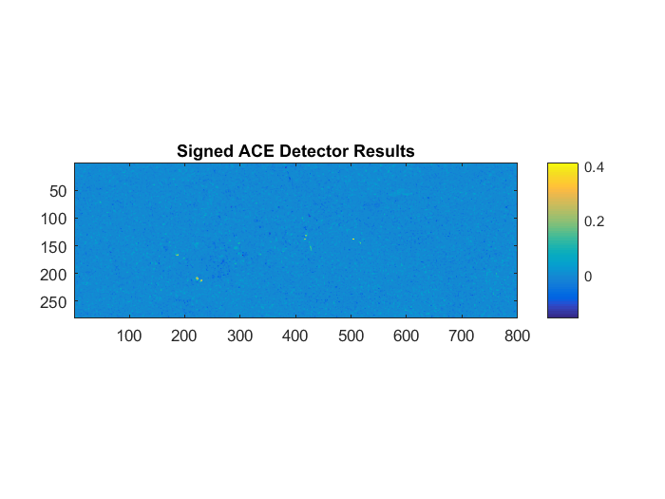


Fabric 1
CEM
ACE
S-ACE
GLRT
Matched Filter
Result of Structured Method
Detector Map

Slide 18
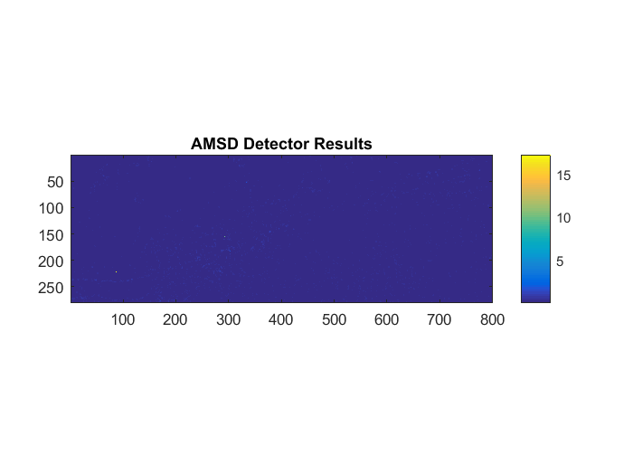
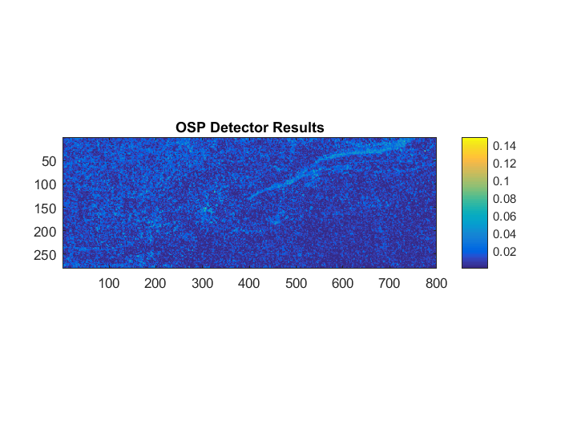
Fabric 1
AMSD
OSP
Result of Unstructured Method
Detector Map
In Unstructured method, first of all estimate number of endmembers
with HFC ,that is 36 , then calculate matrix of background endmembers with ATGP and finally use AMSD and OSP to target detection.

Slide 19
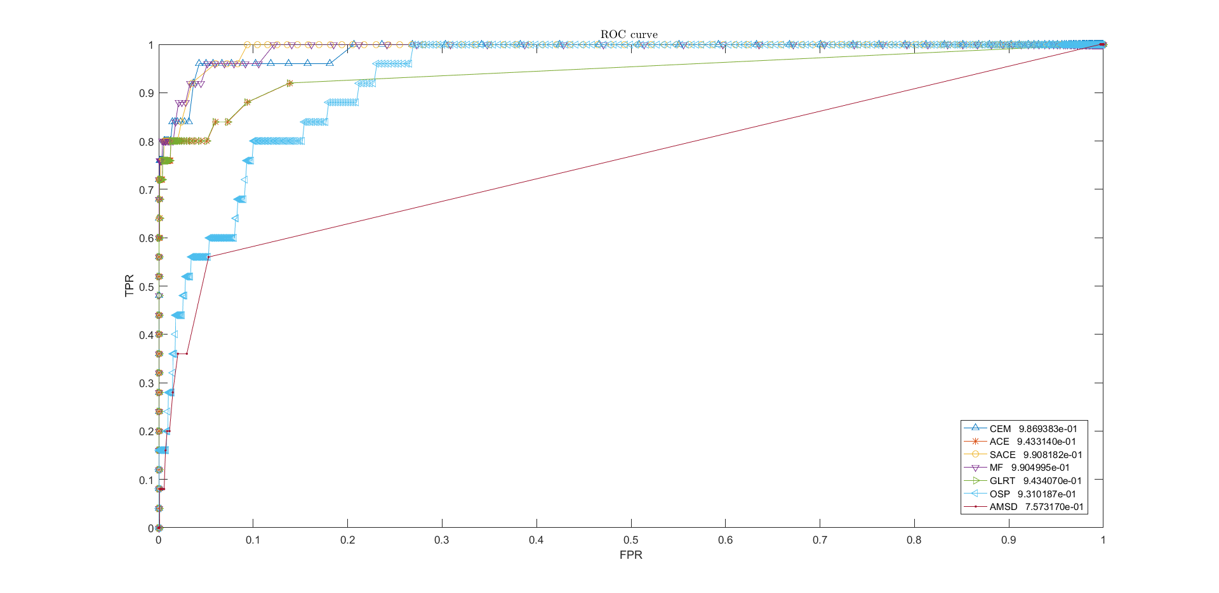
Fabric 1
Method | AUC
CEM | 0.987
ACE | 0.944
SACE | 0.991
MF | 0.991
GLRT | 0.944
OSP | 0.932
AMSD | 0.758
ROC curve of Fabric 1 data for 1000 different thresholds
The AUC of each curve calculated

Slide 20
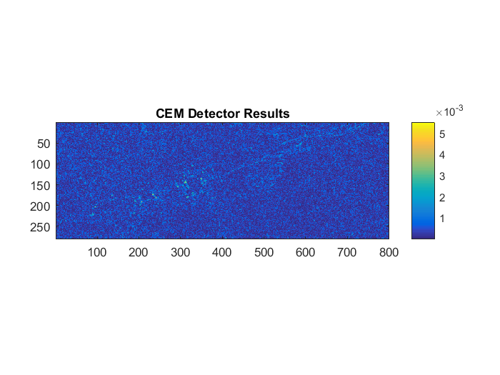
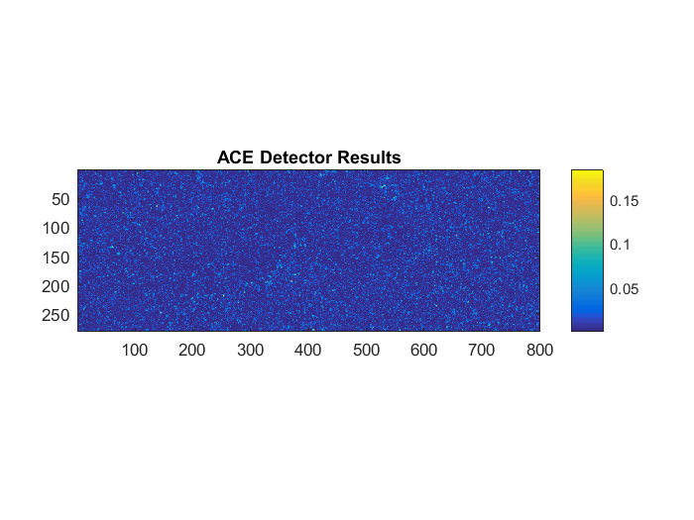
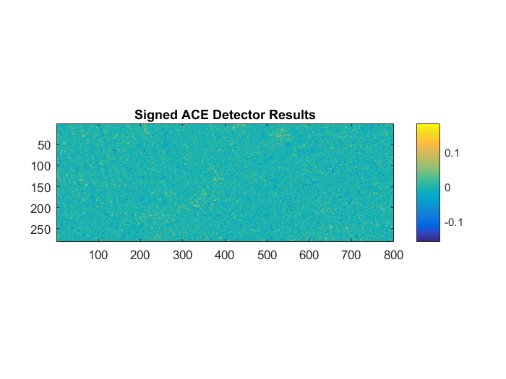
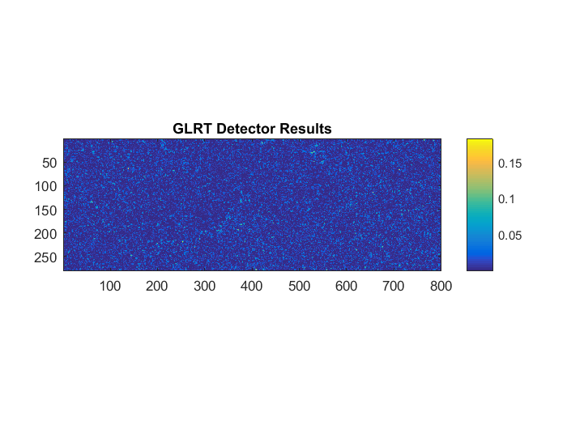
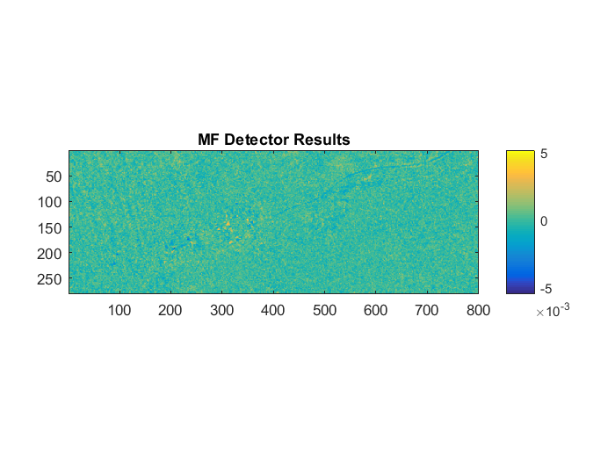
Fabric 2
CEM
ACE
S-ACE
GLRT
Matched Filter
Result of Structured Method
Detector Map

Slide 21

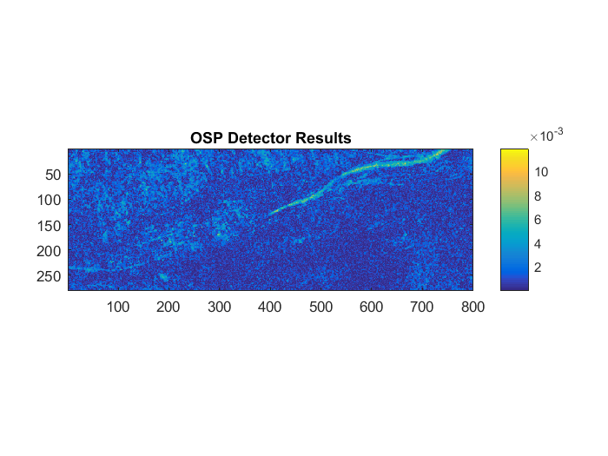
Fabric 2
AMSD
OSP
Result of Unstructured Method
Detector Map
In Unstructured method, first of all estimate number of endmembers
with HFC ,that is 36 , then calculate matrix of background endmembers with ATGP and finally use AMSD and OSP to target detection.

Slide 22
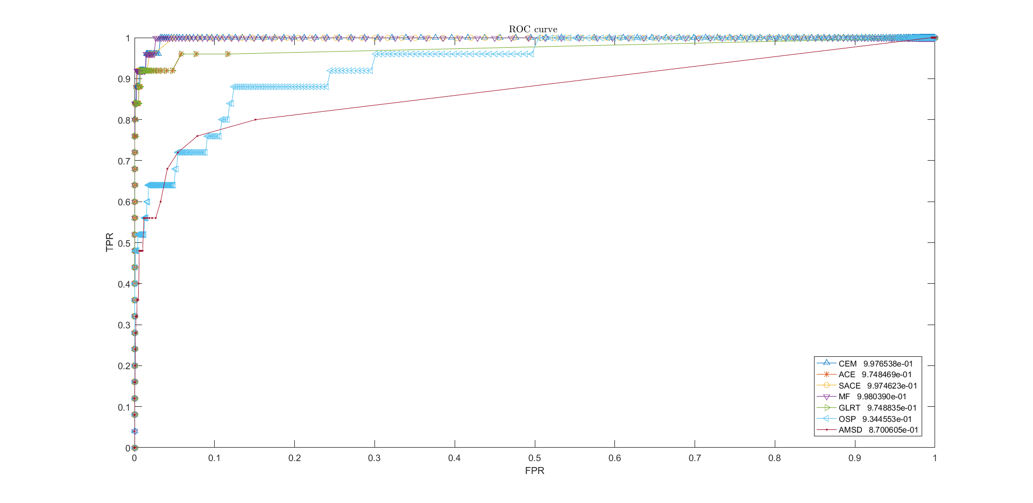
Fabric 2
Method | AUC
CEM | 0.998
ACE | 0.975
SACE | 0.998
MF | 0.999
GLRT | 0.975
OSP | 0.935
AMSD | 0.871
ROC curve of Fabric 2 data for 1000 different thresholds
The AUC of each curve calculated

Slide 23
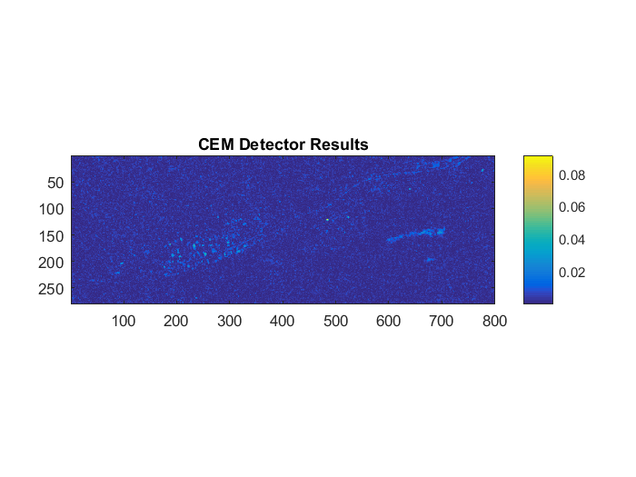
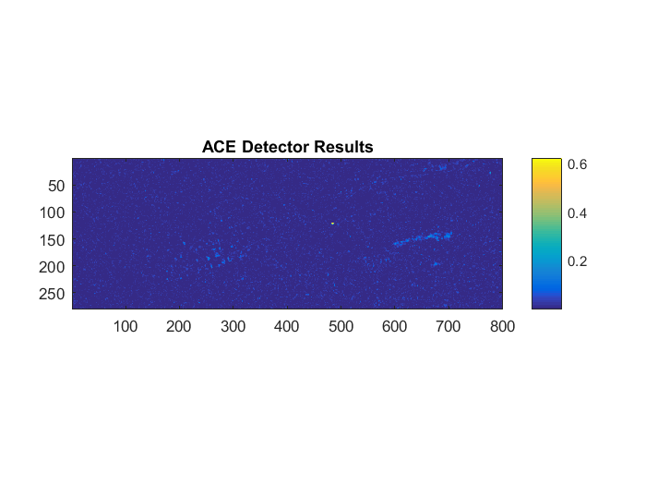


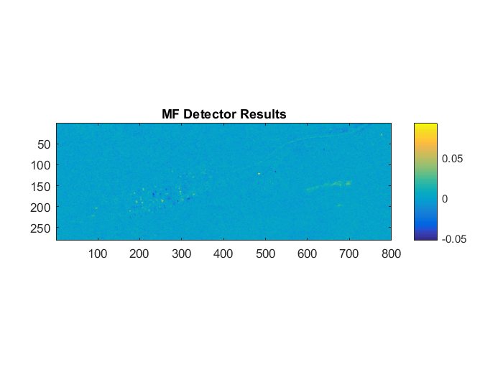
Fabric 3
CEM
ACE
S-ACE
GLRT
Matched Filter
Result of Structured Method
Detector Map

Slide 24

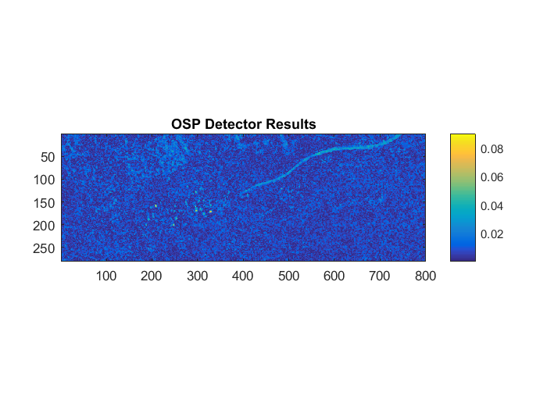
Fabric 3
AMSD
OSP
Result of Unstructured Method
Detector Map
In Unstructured method, first of all estimate number of endmembers
with HFC ,that is 36 , then calculate matrix of background endmembers with ATGP and finally use AMSD and OSP to target detection.

Slide 25
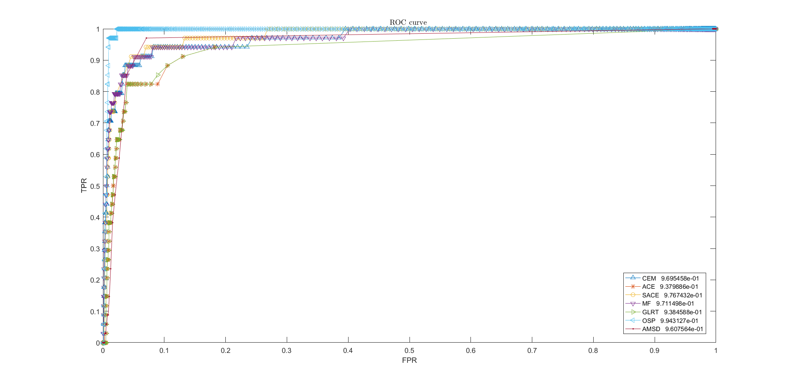
Fabric 3
Method | AUC
CEM | 0.970
ACE | 0.938
SACE | 0.977
MF | 0.972
GLRT | 0.939
OSP | 0.995
AMSD | 0.961
ROC curve of Fabric 3 data for 1000 different thresholds
The AUC of each curve calculated

Slide 26
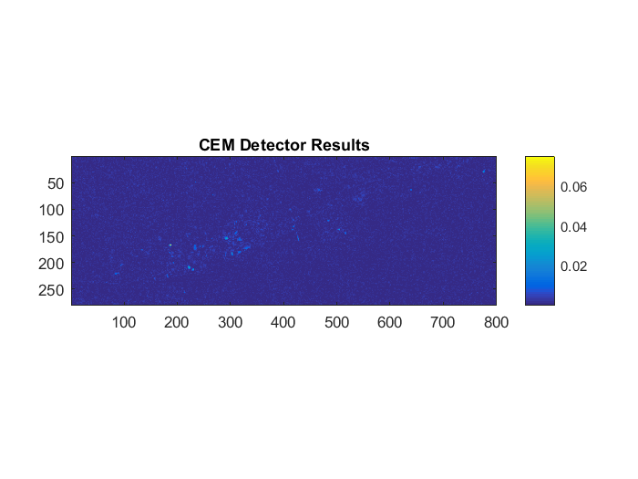
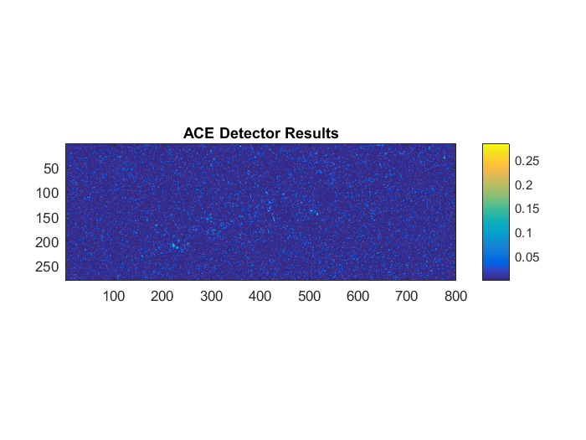



Fabric 4
CEM
ACE
S-ACE
GLRT
Matched Filter
Result of Structured Method
Detector Map

Slide 27
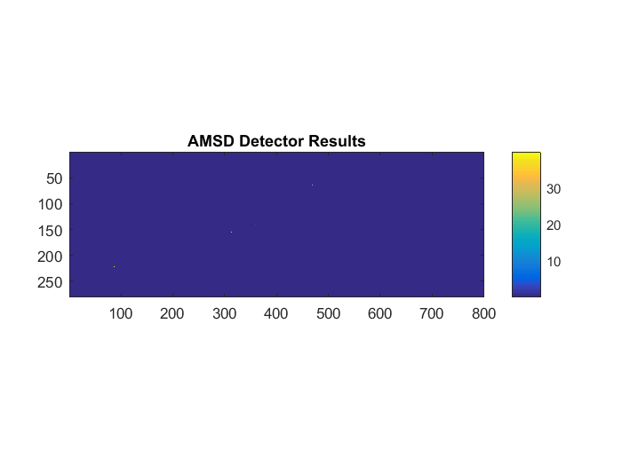
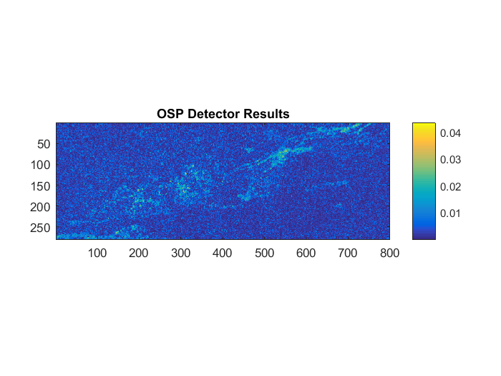
Fabric 4
AMSD
OSP
Result of Unstructured Method
Detector Map
In Unstructured method, first of all estimate number of endmembers
with HFC ,that is 36 , then calculate matrix of background endmembers with ATGP and finally use AMSD and OSP to target detection.

Slide 28
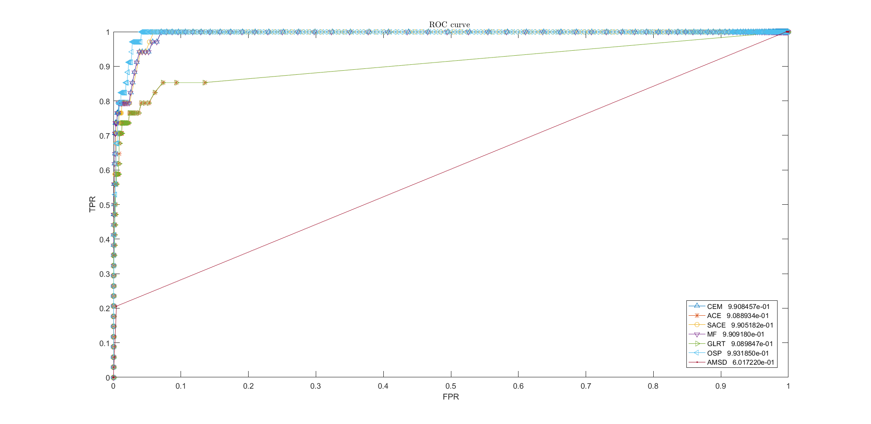
Fabric 4
Method | AUC
CEM | 0.991
ACE | 0.909
SACE | 0.991
MF | 0.991
GLRT | 0.909
OSP | 0.994
AMSD | 2
I think the Results of Unstructured method are related to number of endmembers and number of thresholds
ROC curve of Fabric 4 data for 1000 different thresholds
The AUC of each curve calculated

Slide 29





Vehicle 1
CEM
ACE
S-ACE
GLRT
Matched Filter
Result of Structured Method
Detector Map

Slide 30

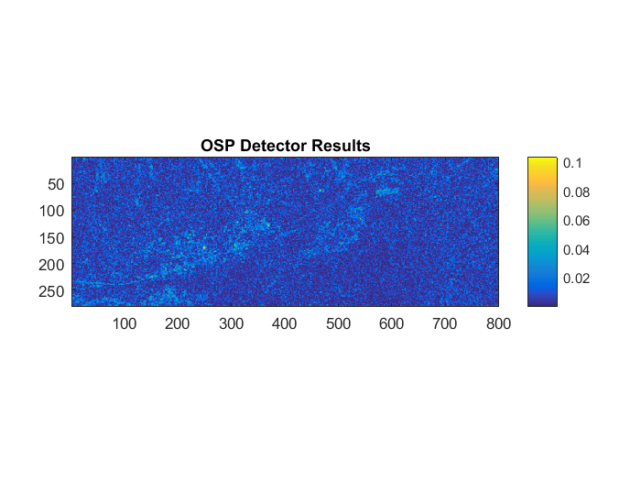
Vehicle 1
AMSD
OSP
Result of Unstructured Method
Detector Map
In Unstructured method, first of all estimate number of endmembers
with HFC ,that is 36 , then calculate matrix of background endmembers with ATGP and finally use AMSD and OSP to target detection.

Slide 31
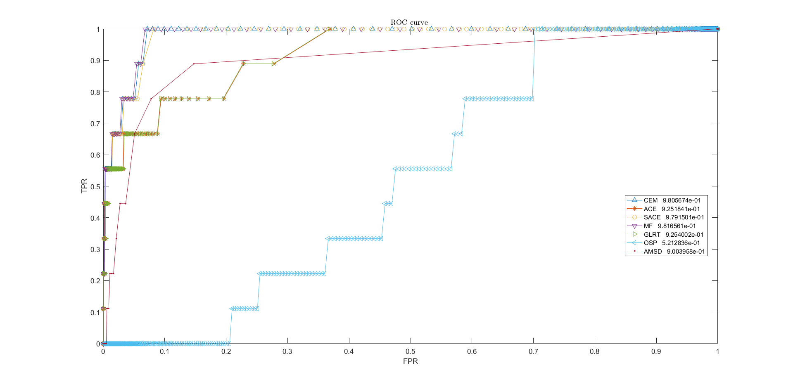
Vehicle 1
Method | AUC
CEM | 0.981
ACE | 0.926
SACE | 0.980
MF | 0.982
GLRT | 0.926
OSP | 0.522
AMSD | 0.901
ROC curve of Vehicle 1 data for 1000 different thresholds
The AUC of each curve calculated

Slide 32





Vehicle 2
CEM
ACE
S-ACE
GLRT
Matched Filter
Result of Structured Method
Detector Map

Slide 33
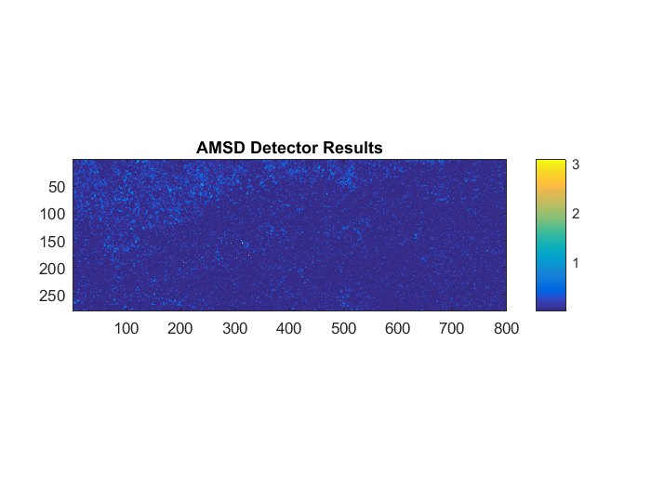
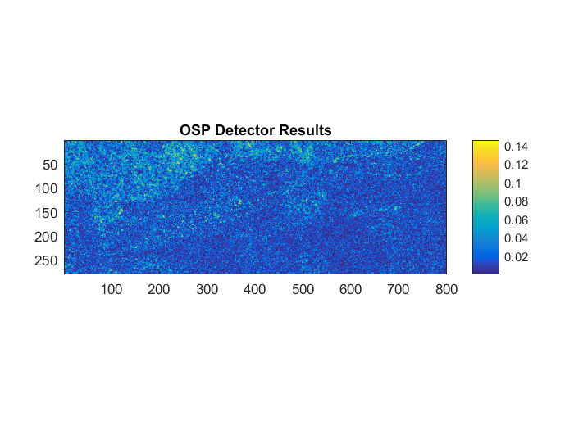
Vehicle 2
AMSD
OSP
Result of Unstructured Method
Detector Map
In Unstructured method, first of all estimate number of endmembers
with HFC ,that is 36 , then calculate matrix of background endmembers with ATGP and finally use AMSD and OSP to target detection.

Slide 34
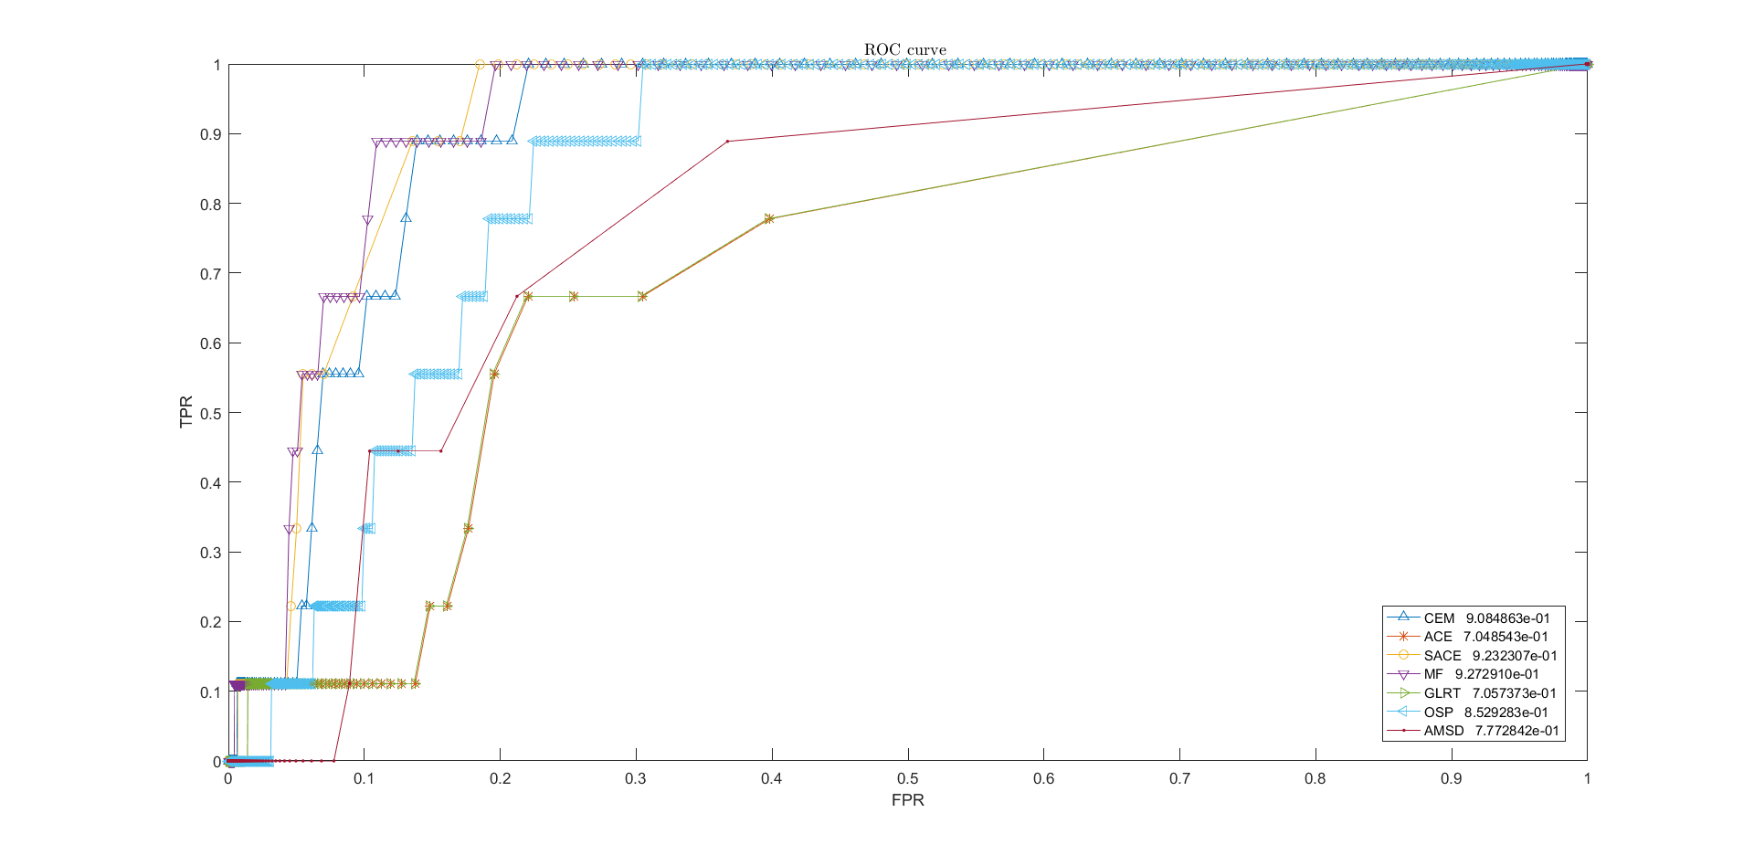
Vehicle 2
Method | AUC
CEM | 0.909
ACE | 0.705
SACE | 0.924
MF | 0.928
GLRT | 0.706
OSP | 0.853
AMSD | 0.778
ROC curve of Vehicle 2 data for 1000 different thresholds
The AUC of each curve calculated

Slide 35
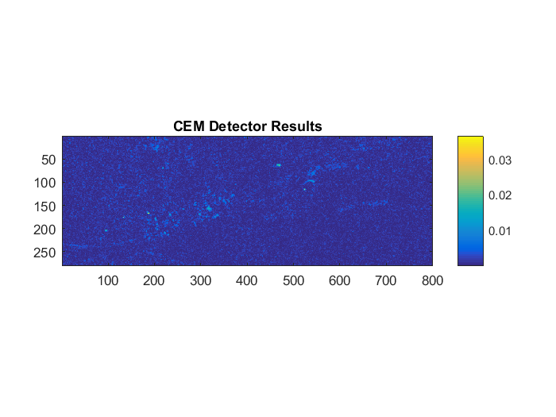

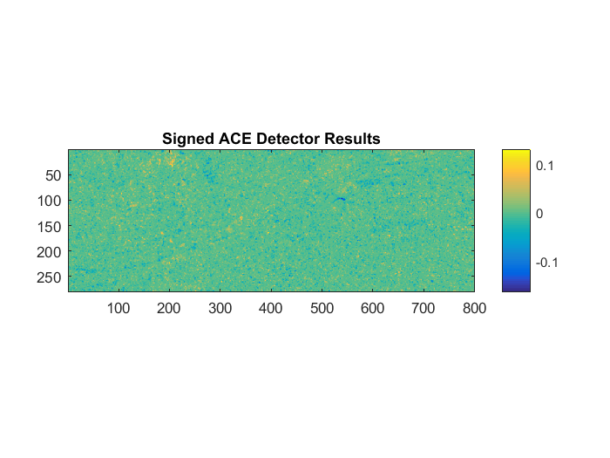


Vehicle 3
CEM
ACE
S-ACE
GLRT
Matched Filter
Result of Structured Method
Detector Map

Slide 36

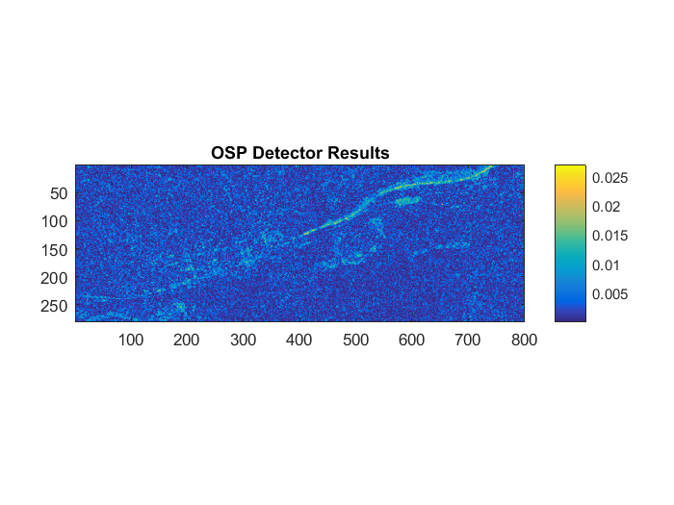
Vehicle 3
AMSD
OSP
Result of Unstructured Method
Detector Map
In Unstructured method, first of all estimate number of endmembers
with HFC ,that is 36 , then calculate matrix of background endmembers with ATGP and finally use AMSD and OSP to target detection.

Slide 37
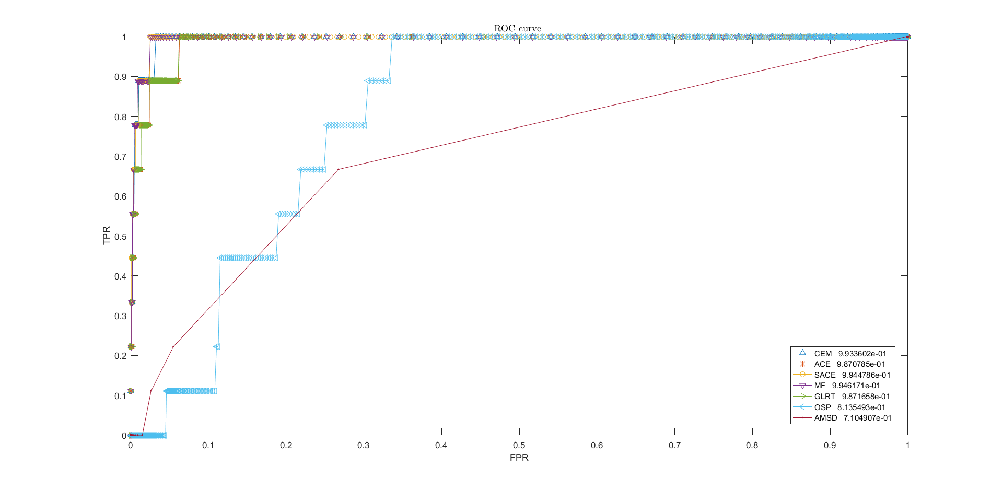
Vehicle 3
Method | AUC
CEM | 0.994
ACE | 0.988
SACE | 0.995
MF | 0.995
GLRT | 0.988
OSP | 0.814
AMSD | 0.711
ROC curve of Vehicle 3 data for 1000 different thresholds
The AUC of each curve calculated

Slide 38
RX Anomaly Detection
HYPERRX RX anomaly detector
hyperRxDetector performs the RX anomaly detector
Usage
[result] = hyperRxDetector(M)
Inputs
M - 2D data matrix (p x N) → 126*224000
Outputs
result - Detector output (1 x N) → 1*224000
sigma - Covariance matrix (p x p) →126*126
sigmaInv - Inverse of covariance matrix (p x p) → 126*126

Slide 39

Fabric 1
Fabric 2
Fabric 3
Fabric 4
Vehicle 1
Vehicle 2
Vehicle 3
RX anomaly detection for targets (detector map)

Slide 40




The End
Thank You
Faezeh Zamiri
References for codes and all of results:
aghdam.zamiri.fa@ut.ac.ir
https://github.com/FaezehZamiri/TargetDetection
Linkedin.com/in/faezeh-Zamiri-1b51081bb
09224015584

